Slide 1

Session 2
Organization : TeachToTech
Instructor : Ayush Raj
Duration : 1.5 hr
(knight @leetcode, 4 ★@codechef, Specialist @codeforces)

Slide 2

Interactive Coding: scanf()
What is scanf()?
Syntax
The opposite of printf—it reads data from the keyboard and stores it in variables.
scanf("format_specifier", &variable_name);
The Golden Rule
Example
Never forget the & (ampersand). It tells the computer the address of where to store the data.
int age;
printf("Enter age: ");
scanf("%d", &age);
Think of & as the GPS location of the variable in memory. In Session 1, we hard-coded values like age = 20. Today, we make the user type it.

Slide 3
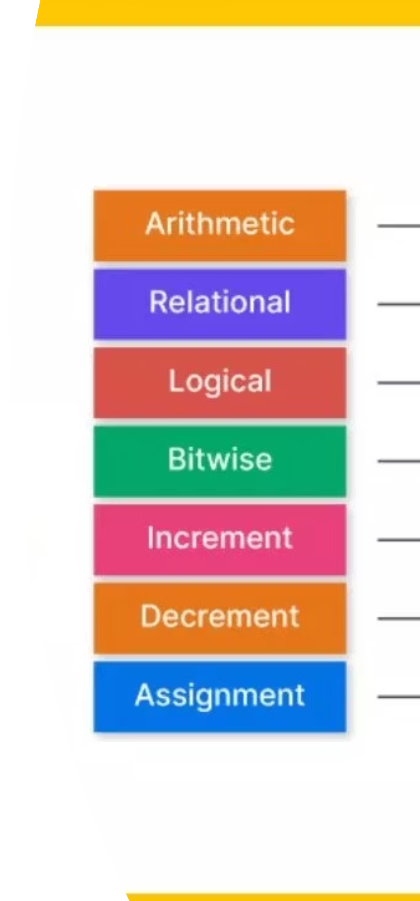
Arithmetic Operators
Basic Math
Modulo (%)
+ (Add)
Gives the remainder after division.
- (Subtract)
Example: 10 % 3 = 1
* (Multiply)
Use Case: Check if number is even or odd (num % 2)
/ (Divide)
Assignment Operators
= (Assigns value)
+= (Add and assign)
Example: a += 5 is same as a = a + 5

Slide 4
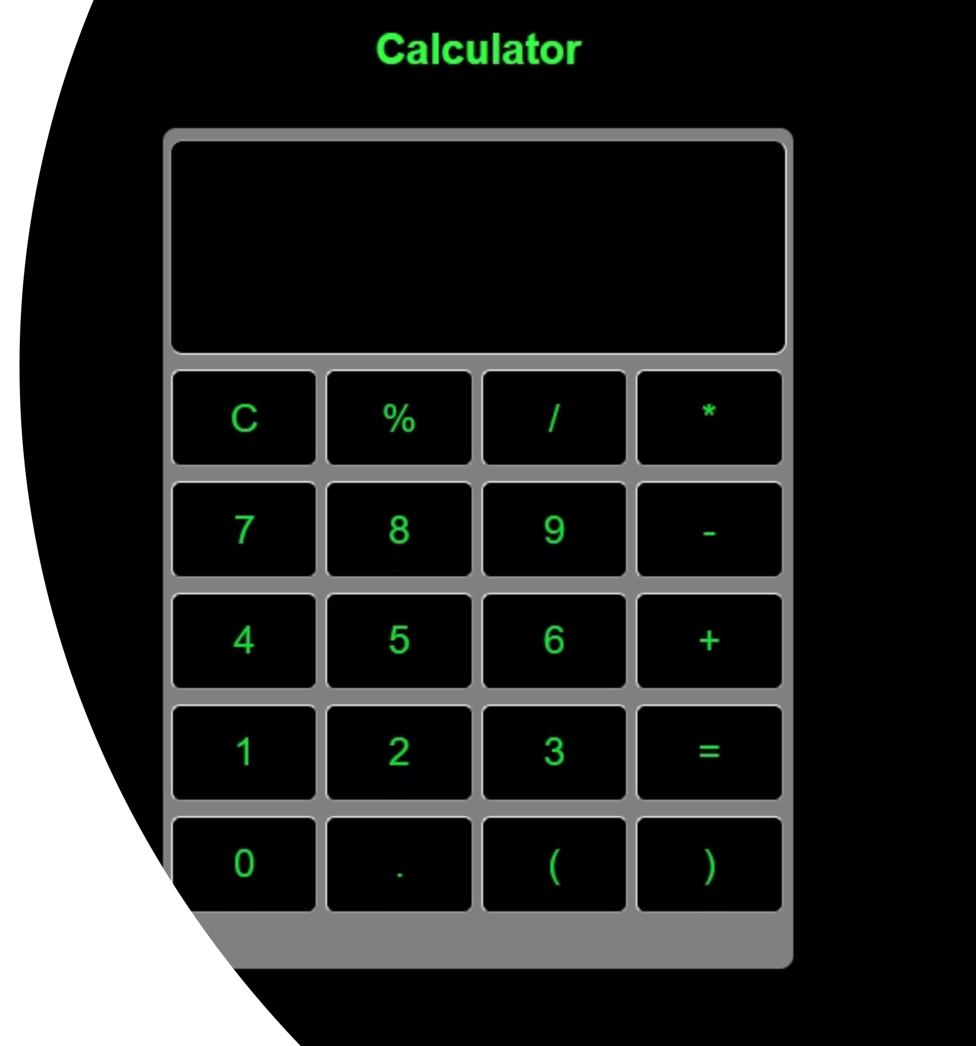

Activity 1: Simple Calculator
Goal: Create a program that takes two numbers and performs addition, subtraction, multiplication, and division.
int main ( ) {
int a, b;
printf("Enter two numbers: ");
scanf("%d %d", &a, &b);
printf("Sum: %d\n", a + b);
printf("Product: %d\n", a * b);
return 0;
}

Slide 5

Relational & Logical Operators
Relational (Comparison)
Logical (Connecting Logic)
Ternary Operator (? :)
> (Greater), < (Less), == (Equal), != (Not Equal)
&& (AND): Both must be true
A one-line if-else statement.
Syntax: (Condition) ? TruePart : FalsePart;
Result: Returns 1 (True) or 0 (False)
|| (OR): At least one must be true
! (NOT): Reverses the result

Slide 6
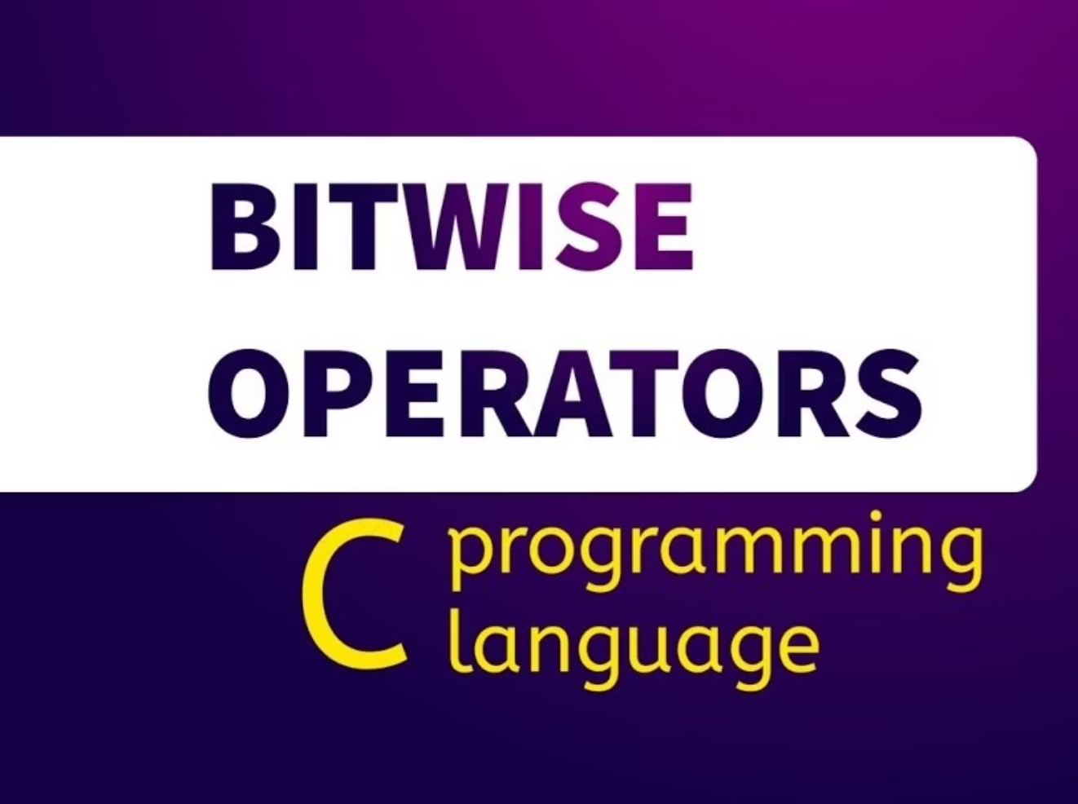
Bitwise Operators: The Heavy Lifters
Why Use Them?
& (AND)
They work directly on binary bits (0s and 1s). Fast and used in competitive programming.
Both bits must be 1
| (OR)
At least one bit is 1
^ (XOR)
Bits must be different
<< (Left Shift)
Multiplies by 2
>> (Right Shift)
Divides by 2

Slide 7
Problem Solving : Digit Logic
Subtract the Product and Sum of Digits
01
02
03
Get Last Digit
Remove Last Digit
Repeat Until Zero
Use % 10 to extract the last digit
Use / 10 to remove the last digit
Continue until the number becomes 0
Example: n = 234
Product = 2 × 3 × 4 = 24
Sum = 2 + 3 + 4 = 9
Result = 24 - 9 = 15

Slide 8




Leetcode problem QR
Problem 1
Problem 2
Problem 3
Problem 4
Sum of Two Integers - LeetCode
Subtract the Product and Sum of Digits of an Integer - LeetCode
Number of 1 Bits - LeetCode
Divide Two Integers - LeetCode

Slide 9

Homework Assignment
Divide Two Integers by 2
Bit Magic
Solve without using / operators. Hint: Use bit shifting.
Check number is even or odd.
Practice these problems to master operators and bit manipulation. See you in the next session!

